Slide 1
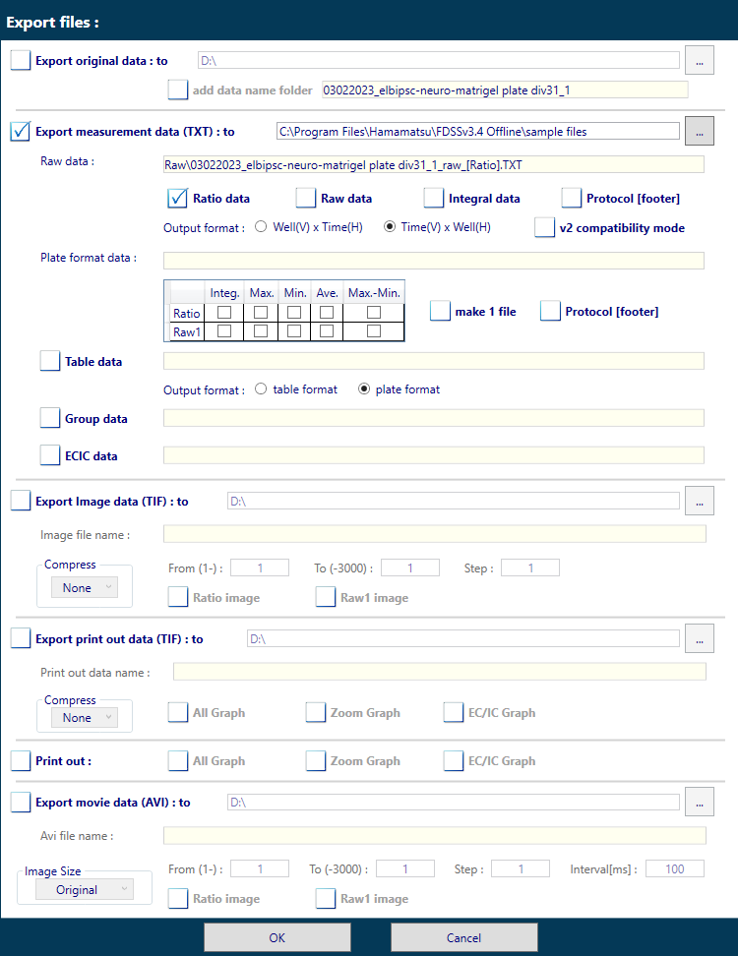
To export a valid TXT file, make sure to comply with the following setting
No need to export original data
Export TXT file
Specify data type (ratio or raw)
Specify Time(V) x Well(H)
or
Leave any other settings unchecked

